Slide 1
SBA Loan Approval
Group 13
MD Akber Hossain
Rene Konig
Atanu Das
Fatema Tuz Zohra
Tapas Chandra Dev

Slide 2
Project Outline
1. Problem Statement
2. Understanding the Data
3. Data Cleaning
4. Data Visualization
5. Data Preprocessing
6. Basic Model Building and Evaluation
7. Model Tuning
8. Model Evaluation and Comparison
9. Results & Findings
10. Future Work and Conclusion

Slide 3
Problem Statement
Should a loan be approved or not?

Slide 4
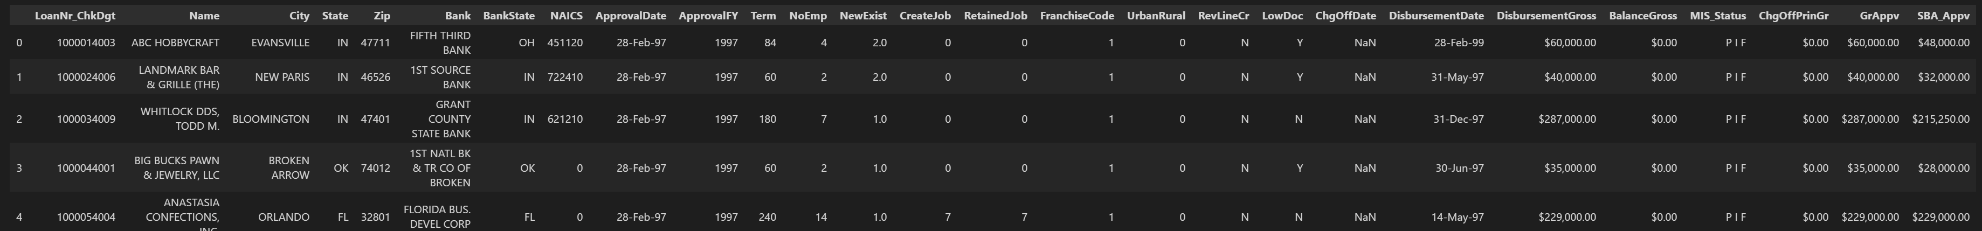
Understand the data
…
The dataset is from the U.S. Small Business Administration (SBA)
The original shape of the dataset is 899164 rows and 27 columns
Text, Datetime, Number & Currency
82% PIF, 18% CHGOFF → The dataset is highly unbalanced

Slide 5
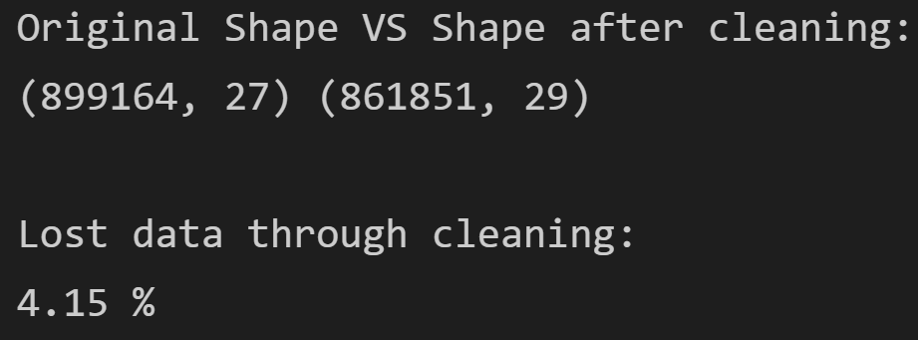
Data cleaning
Convert monetary & date values into numerical values & Timeseries
Simplify NAICS & ZIP code to first 2 & 3 digits
Group and drop irrelevant rows
Remove outliers & drop nulls
Charge off date: 81.9% missing values → column removed
Rest of the columns: <0.6% missing values → rows containing nulls removed

Slide 6
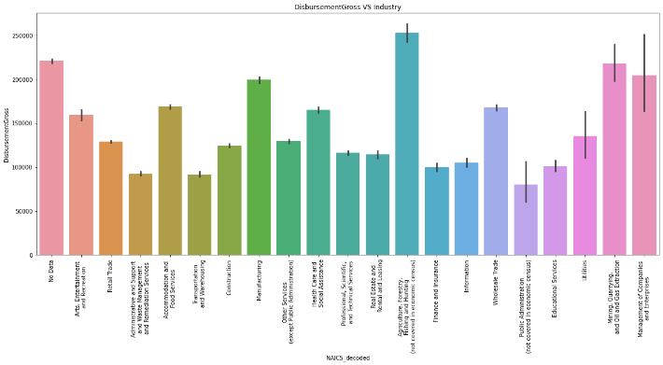
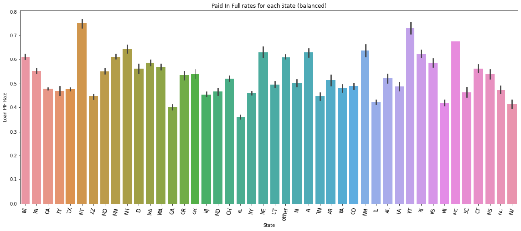
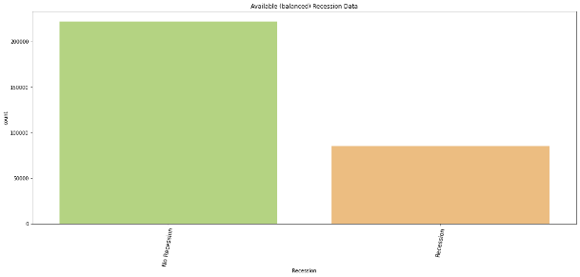
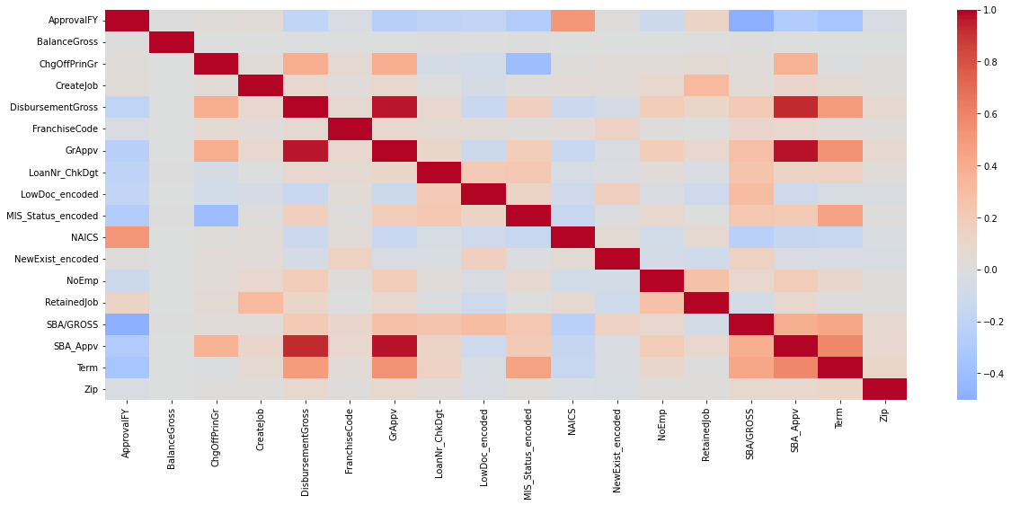
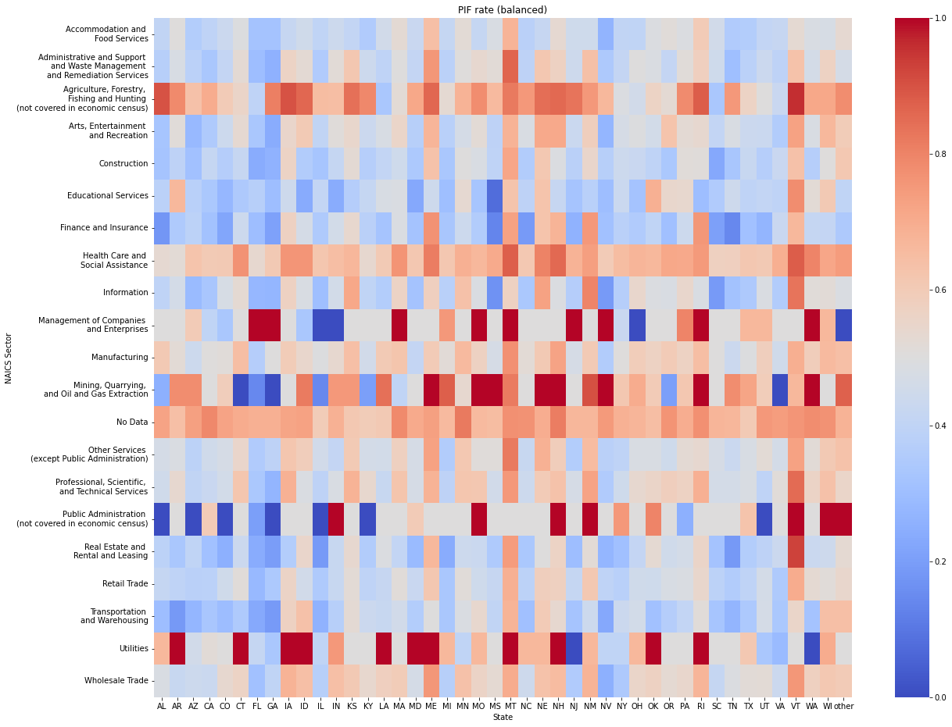
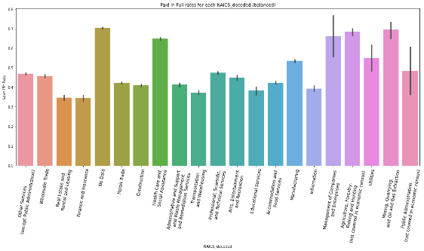
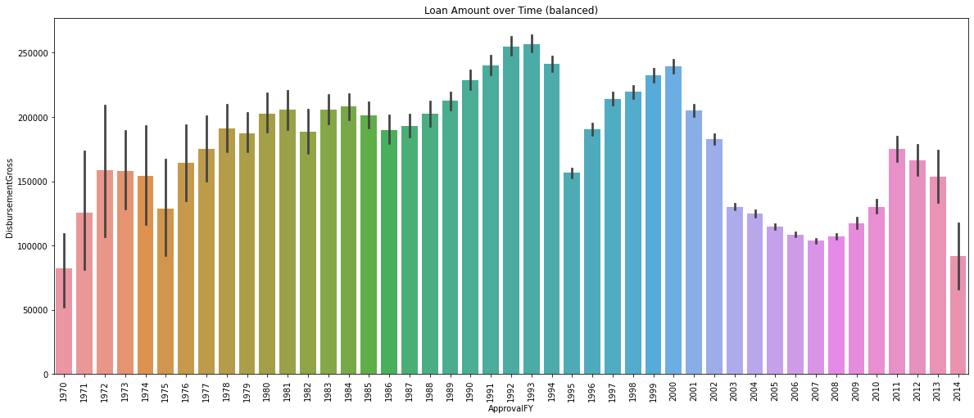
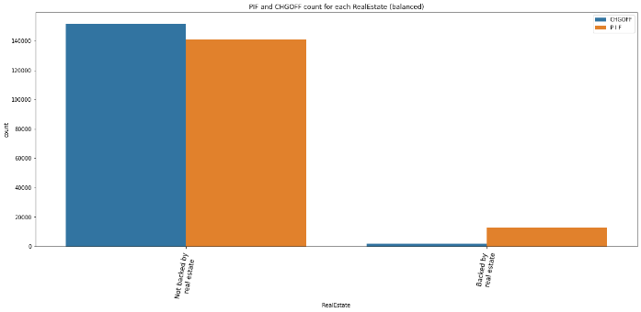
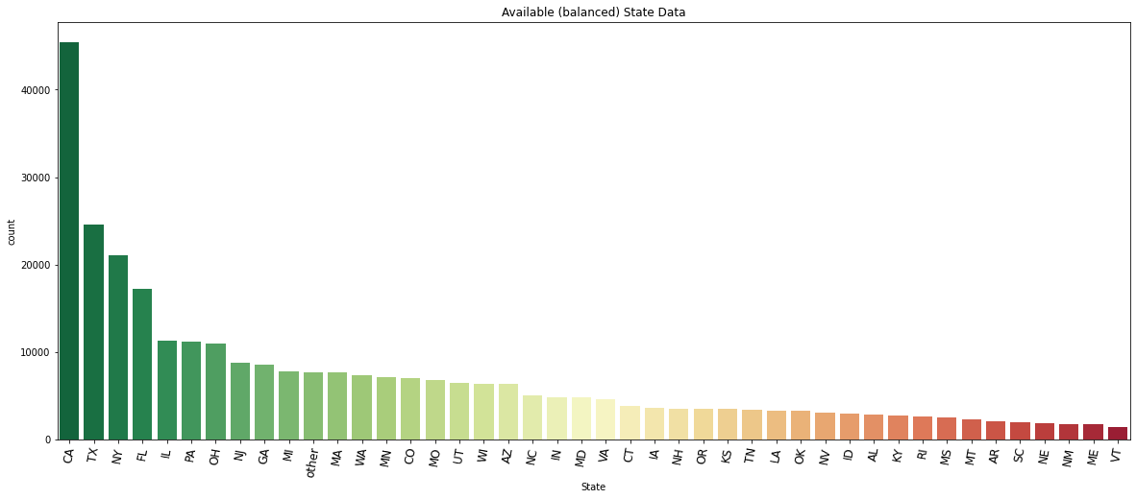
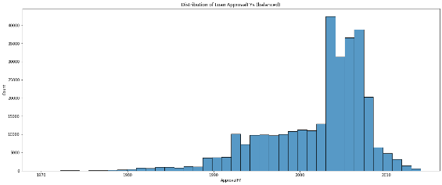
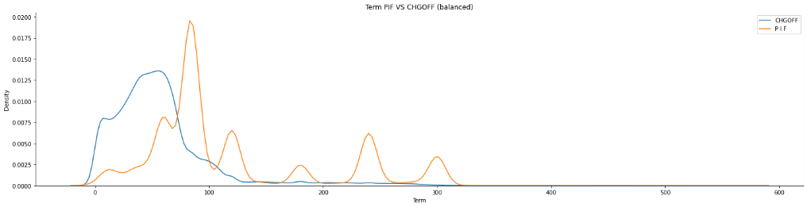
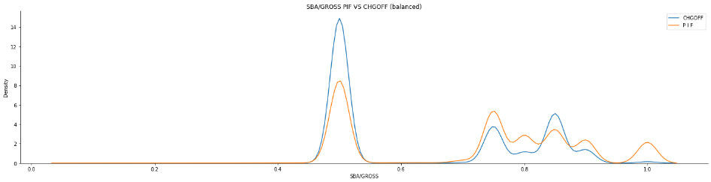
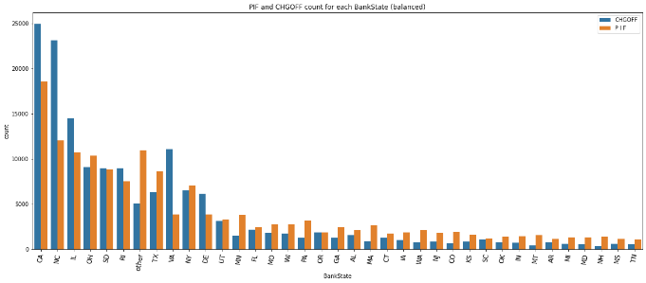
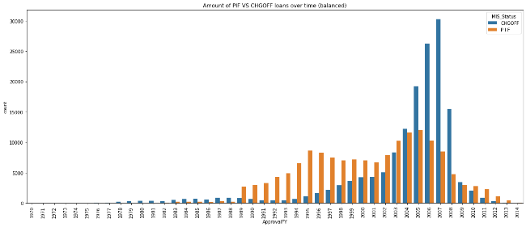
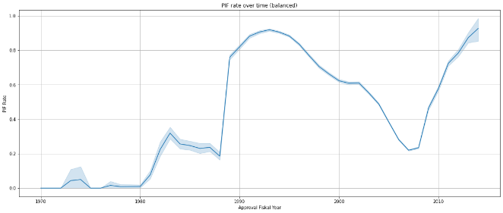
Data Visualization
Categorical Data: ['State','BankState','NAICS_decoded','NewExist','UrbanRural','RevLineCr','LowDoc','RealEstate','Recession']
Available Data
Paid in Full rates
Paid in Full counts
Numerical Data: ['ApprovalFY','Term','NoEmp','CreateJob’,…,'DisbursementGross','BalanceGross','ChgOffPrinGr','GrAppv','SBA_Appv','SBA/GROSS']
Data Distribution
PIF VS CHGOFF
Industry Visualization:
Avg Terms
Avg Loan Amount
PIF rate for Industry and State
Development over Time:
Number of Loans
PIF vs CHGOFF
PIF rate
Loan Amount
Avg Jobs created per loan
Job Survey
Correlation Matrix

Slide 7
Data Visualization
A lot of loan data from California

Slide 8
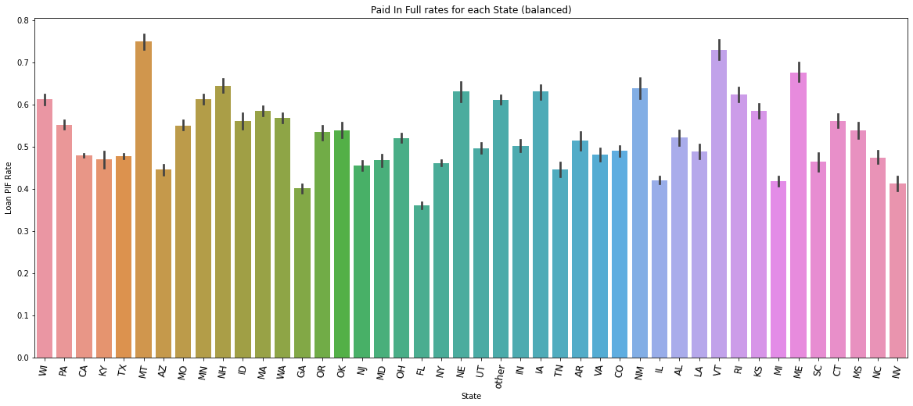
Data Visualization
High PIF rate in Montana
Low PIF rate in Florida

Slide 9
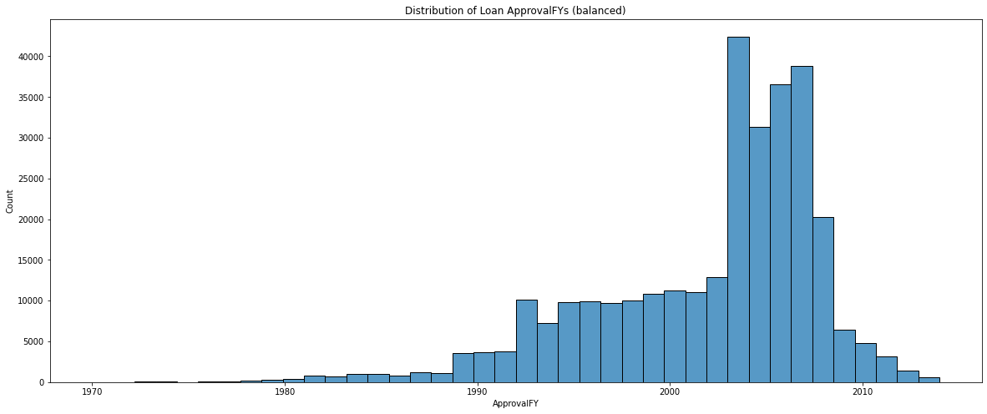
Data Visualization
High number of loans between 2003 and 2008

Slide 10
Data Visualization
Low average loan amounts between 2003 and 2010

Slide 11
Data Visualization
Avg. PIF / CHGOFF rate
…
…
High PIF rates in Healthcare and Social Assistance across all states
High PIF rates in Montana across all Industries

Slide 12
Data Preprocessing(Features Engineering)
Target behavior of features from raw data is engineered
15 possible features were generated from 27 raw data columns
The possible features are:
Possible Features | Name of the Column
Loan Active Term | Term
SBA Guaranteed Portion | Portion_SBA_Guaranteed
Gross Amount Approved | GrAppv
Gross Amount Disbursed | DisbursementGross
Default Rates of Different States | State_Default_Rate
Default Rates of Different Industrial Sectors | Sector_Default_Rate
Revolving Line of Credit | RevLineCr
Has Permanent employee | RetainedJob
Opened New Employment | CreateJob
Number of employees | NoEmp
New or Existing Business | NewExist
Recession | Recession
Loan backed by Real Estate | RealEstate
Franchise Code | FranchiseCode
DAT540 - Group Project - Group 13
29/11/2021
12
Table: Possible Features

Slide 13
Data Preprocessing(Features Selection)
14 features were selected
The selected features are:
Behavior and Feature importance
Observed with:
Possible Features | Name of the Column
Loan Active Term | Term
SBA Guaranteed Portion | Portion_SBA_Guaranteed
Gross Amount Approved | GrAppv
Gross Amount Disbursed | DisbursementGross
Default Rates of Different States | State_Default_Rate
Default Rates of Different Industrial Sectors | Sector_Default_Rate
Revolving Line of Credit | RevLineCr
Has Permanent employee | RetainedJob
Opened New Employment | CreateJob
Number of employees | NoEmp
New or Existing Business | NewExist
Recession | Recession
Loan backed by Real Estate | RealEstate
SelectKBest with f_classif
SelectKBest with chi2
LGBMClassifier
XGBoostClassifier
Table: Selected Features
DAT540 - Group Project - Group 13
29/11/2021
13

Slide 14
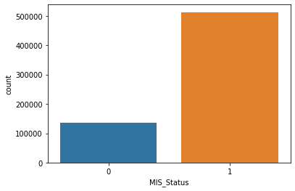
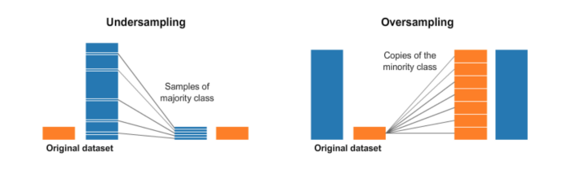
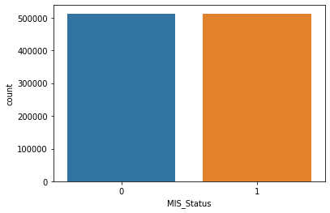
Data Preprocessing(Data Balancing)
Ratio of the classes of label was approximately 1:5.
Scaled dataset by StandardScaler metheod
Pipelined Oversampling and Undersampling
to balance label data
Oversampling method: ADASYN
Undersampling method: RandomUndersampler
Fig: Imbalanced Dataset
Fig: Undersampling and Oversampling of Dataset
Fig: Balanced Dataset
DAT540 - Group Project - Group 13
29/11/2021
14

Slide 15
Model Building (Select Models)
After preparing, cleaning and preprocessing the data
We have used 6 models initially for predicting (fitting) about Loan Approval
For Using the Model, we initially split the data into train (80%) and test set (20%).
Then through our custom fit_and_score function we fit and calculate some basic score.
We used MinMaxScaler for Scaling the train set of all features and target/label column before fit the model.
We predicted using test data and used predicted value for scoring and visualize confusion matrix.
Random Forest Classifier
XGB Classifier
Logistic Regression
KNN Classifier
Gaussian NB Classifier
Decision Tree Classifier

Slide 16
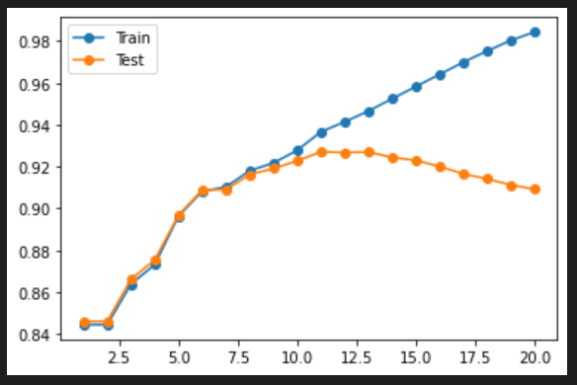
Model Building (Fit the models and Calculate Score)
Scores:
Using Cross Validation for evaluate and get exact accuracy by mean the CV scores we get approx 75.5%.
Too good score !!!
Data Leakage happens when the data you are using to train a machine learning algorithm happens to have the information you are trying to predict.
Leaky Predictors
Pre-processing
Normalization
Missing Value Imputation
Models | Accuracy | Precision
Logistic Regression | 74% | 76.5%
Random Forest Classifier | 73.8% | 87%
XGB Classifier | 70.3% | 92%
KNN Classifier | 82.7% | 92%
Gaussian NB Classifier | 59.5% | 62.5%
Decision Tree Classifier | 53.8% | 56.3%
Features are not in proper Normal distribution. So we have used StandardScaler to see if it can help score a bit better for GaussianNB.
Perform data preparation within your cross validation folds *
The cause of poor performance in machine learning is either overfitting or underfitting the data.
Overfitting refers to an unwanted behavior of a machine learning algorithm used for predictive modeling.
to limit overfitting we used resampling technique which is k-fold cross validation and got score of 78%.
* Future Work

Slide 17
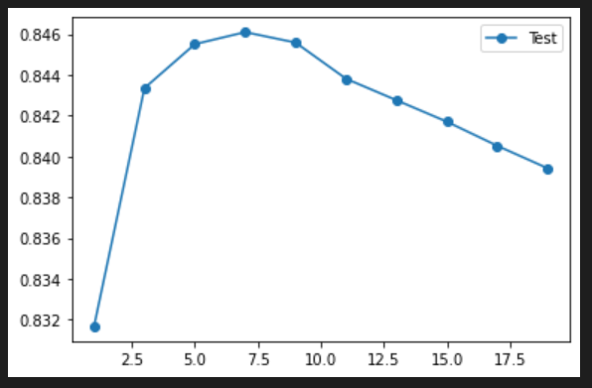
Model Tuning (Apply Hyperparameters)
We have modified the hyperparameter for tailor the behavior of the algorithm. Like for KNN algorithm we tried with parameter n_estimators from 1 to 20.
We tried to Tune 4 of the algorithm we chose before and applied various hyperparameter value on those and tried to estimate the best score with best parameters. For the whole scenario we used first
RandomizedSearchCV
Score
Here for n_neighbors = 7 score is the highest
We iterate this for 20t times which randomly applied the parameters and from these with the help of best_params_ we make another efficient parameter set for
GridSearchCV
And finally, after applying this we got the most efficient parameter set for our model. We get the best scores.
n_neighbors

Slide 18
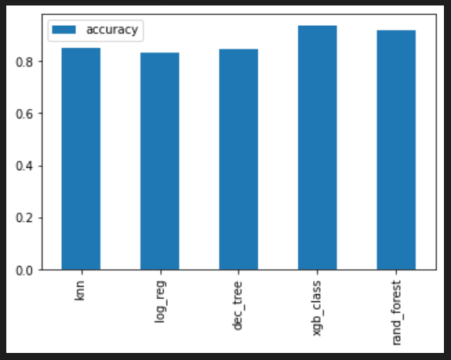
Model Tuning (Improve the previous scores)
Like for Random Forest Classifier:
With default hyperparameter | With tuned hyperparameter
73.8% | 93%
Scores:
n_estimators: 250 min_samples_split: 24 min_samples_leaf: 1 max_depth: 50
After tuning and compared the scores
Like for XGB Classifier:
colsample_bytree: 0.4 gamma: 0.0 learning_rate: 0.15
max_depth: 6
min_child_weight: 4
With default hyperparameter | With tuned hyperparameter
70.3% | 95.4%
Scores:

Slide 19
Model Evaluation and Compare
Model Evaluation is an integral part of the model development process. It helps to find the best model that represents our data and how well the chosen model will work in the future.
We have evaluated, compared and shown the results by using below terms:
Precision Recall Curve
ROC Curve
Confusion Matrix
Classification Report
Voting Classifier
DAT540 - Group Project - Group 13
29/11/2021
19

Slide 20
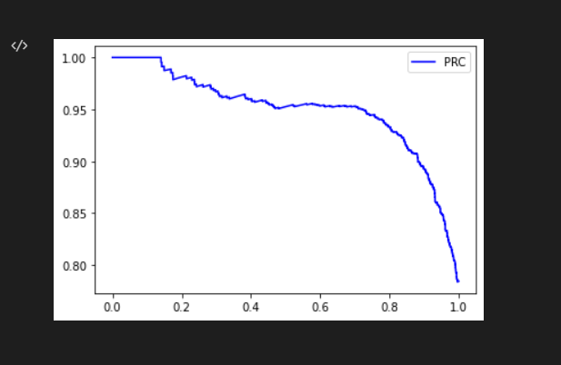
Precision Recall Curve
This Precision Recall curve shows the tradeoff between precision and recall for different thresholds.
A precision-recall curve is a plot of the precision (y-axis) and the recall (x-axis) for different thresholds.
DAT540 - Group Project - Group 13
29/11/2021
20

Slide 21
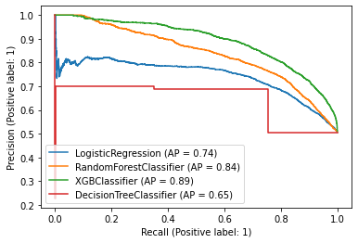
Precision Recall Curve of Four Different Models
y-axis
x-axis
DAT540 - Group Project - Group 13
29/11/2021
21

Slide 22
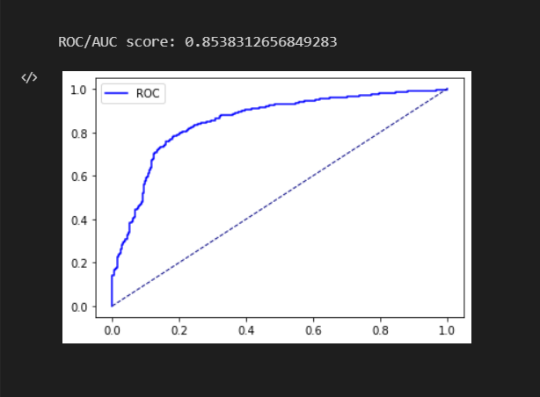
Receiver Operating Characteristic (ROC) Curve
It is a plot of True Positive Rate (y-axis) against the False Positive Rate (x-axis).
It provides a graphical representation of a classifier’s performance, rather than a single value.
The curves of different models can be compared directly in general or for different thresholds.
We can also get The Area under the Curve (AUC) by ROC Curve. The AUC can be used as a summary of the model skill.
DAT540 - Group Project - Group 13
29/11/2021
22

Slide 23
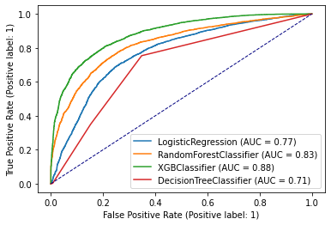
The Comparison of ROC curve of four different models
y-axis
x-axis
DAT540 - Group Project - Group 13
29/11/2021
23

Slide 24
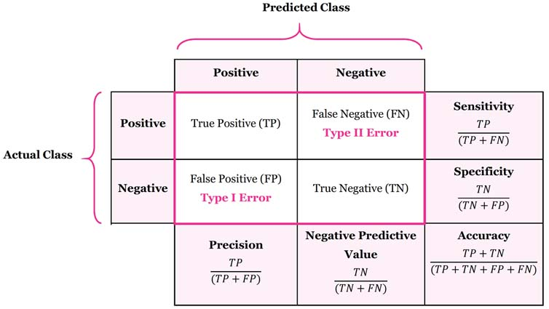
Confusion Matrix
It is a very popular measure used while solving classification problems.
We have used this matrix to measure Recall, Precision, Accuracy, Error Rate & F1_Score.
A good matrix (model) will have large values across the diagonal and small values off the diagonal.
DAT540 - Group Project - Group 13
29/11/2021
24

Slide 25
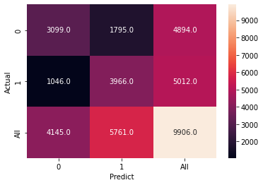
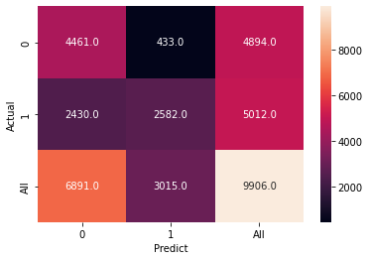
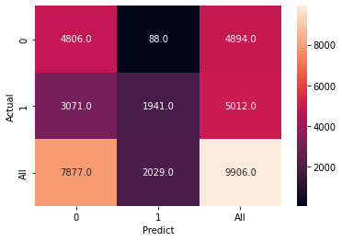
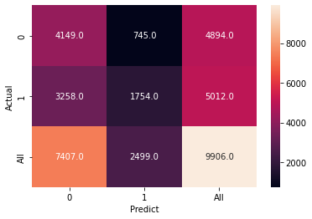
Confusion Matrix of Four Different Models
Logistic
Random Forest
XGB
Decision Tree
DAT540 - Group Project - Group 13
29/11/2021
25

Slide 26
Classification Report
It is about key metrics in a classification problem.
We have precision, recall, f1-score and support values for each class we're trying to find.
The support is the number of occurrence of the given class in our dataset which allows us to know whether it is a balanced or imbalanced dataset.
DAT540 - Group Project - Group 13
29/11/2021
26

Slide 27
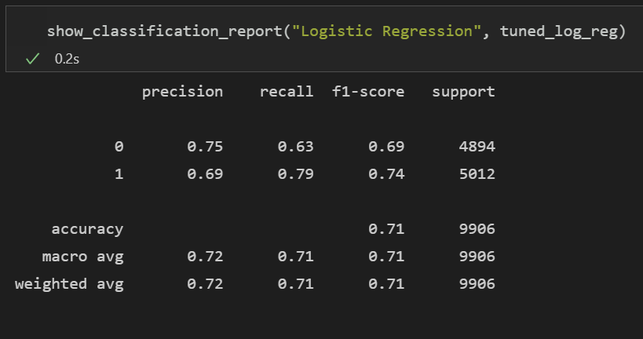
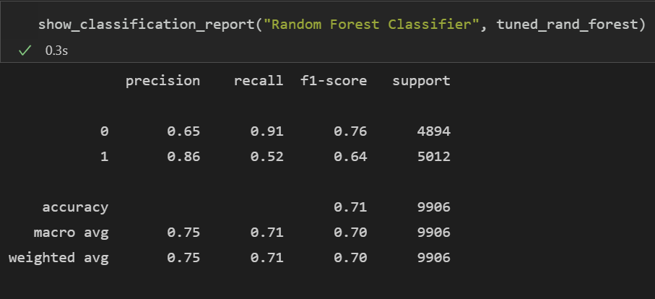
Classification Reports of Four Different Models
Logistic Regression and Random Forest Classifier:
DAT540 - Group Project - Group 13
29/11/2021
27

Slide 28
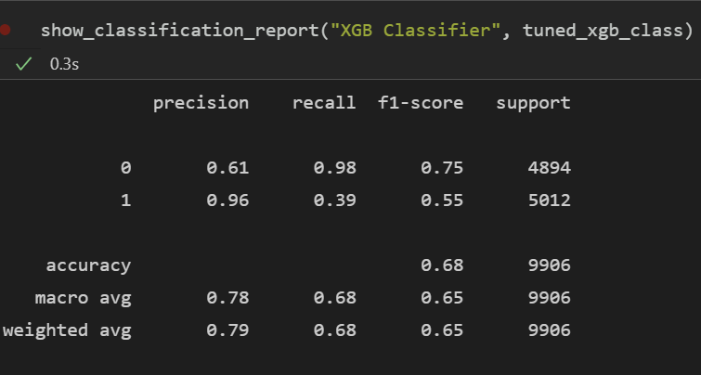
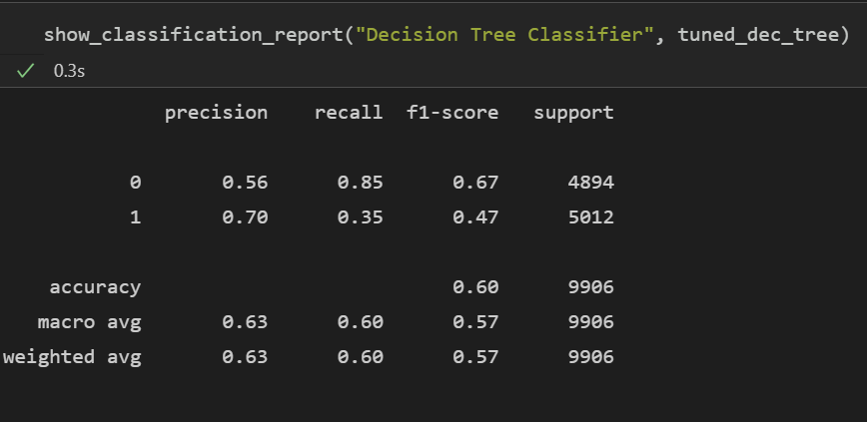
Classification Reports of Four Different Models
XGB Classifier and Decision Tree Classifier:
DAT540 - Group Project - Group 13
29/11/2021
28

Slide 29
Hard Voting Classifiers
Hard voting classifier classifies input data based on the mode of all the predictions made by different classifiers.
When majority voting is taken based equal weights, mode of the predicted label is taken.
Using Hard Voting Training in all models, the Mean value is: 87.32
DAT540 - Group Project - Group 13
29/11/2021
29

Slide 30
Soft Voting Classifiers
Soft voting classifier classifies input data based on the probabilities of all the predictions made by different classifiers.
By using Soft Voting Classifier in all models, the Mean value is: 91.13
DAT540 - Group Project - Group 13
29/11/2021
30

Slide 31
Thank You!

